Slide 1
Discipleship & Mentoring
Notes:
Welcome to our class on Discipleship & Mentoring

Slide 2
Session purpose
The purpose of this session is to inform us of who Jesus’ disciples are, and motivate us to live as Jesus’ disciples
Topics:
1.Who is a disciple of Christ (Characters of discipleship)
2.Growing as disciples of Christ (Responsibilities, cost and blessing)
3. Mentoring others as Jesus’ disciples.
:
Notes:
We welcome you to our class on Discipleship & Mentoring.
In our first two classes we talked about Growing in a personal relationship with Christ as Lord and Growing as a community with Christ as Lord.
These are necessary steps for our growth in Christian life but God has an even greater plan for using the community he builds.
God wants us to reach out beyond the church, to reach out far beyond our communities and the way we can accomplish that is through discipleship & Mentorship.
In This class we will learn how to be disciples of Jesus, and will discuss how we can help others to become disciples of Jesus through faith and obedience to Jesus’ teachings

Slide 3
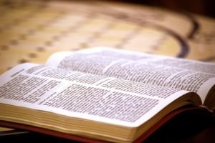
Discipleship & Mentoring
“If you hold to my teaching, you are really my disciples”
John 8:31
Notes:
The spirit of becoming a disciple of Christ begins with holding on to his word
Let’s read the Key verse.
We pray that God may open our spiritual eyes and ears so that we may see and hear his word and obey them and put them to practice, and by doing this we can grow into his disciples.

Slide 4
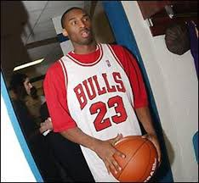
Who Is a Disciple?
Dictionary defines a disciple as a follower or a learner of the doctrines of a teacher or a school of thought.
Notes:
What does “Disciple” mean?
A disciple is defined as a person who is a learner or follower of the principles of another. a disciple is also the one who embraces and assists in spreading the teaching of another. Or any follower of another person.
Based on these descriptions one may conclude that we are all a disciples already in one way or another.
Think of a favorite movie or sport star that you grew up trying to imitate “ just like Mike” for the love of basketball; maybe it’s something different.
But as Christians whose disciples are we to be?

Slide 5
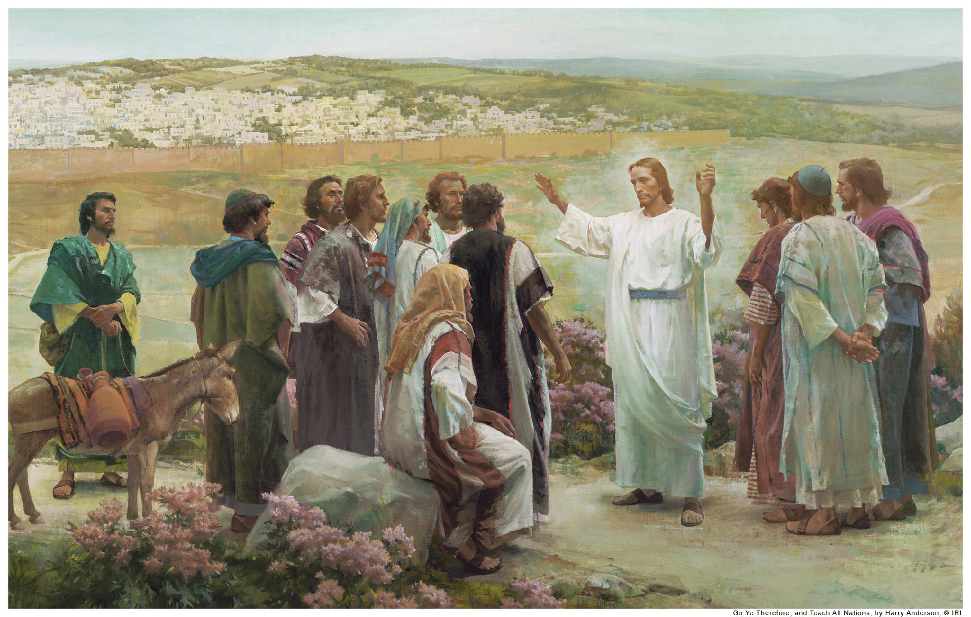
Who are Jesus’ Disciples?
Matthew 4:18-22
Notes:
Jesus’ disciples are those who are called by Jesus to follow him, let see what the Bible says about that
Please read:
Matthew 4:18-22” As Jesus was walking beside the Sea of Galilee, he saw two brothers, Simon called Peter and his brother Andrew. They were casting a net into the lake, for they were fishermen. 19“Come, follow me,” Jesus said, “and I will send you out to fish for people.” 20At once they left their nets and followed him.
21 Going on from there, he saw two other brothers, James son of Zebedee and his brother John. They were in a boat with their father Zebedee, preparing their nets. Jesus called them, 22and immediately they left the boat and their father and followed him.
Here we can see that Jesus’ Disciples of all generations are those who hear the call and accept the invitation to follow Jesus. They obey Jesus’ teachings by faith, and love God with everything they have. by God’s grace, through a life of faith and obedience to Jesus’ teachings they grow to become more and more like Christ Himself.

Slide 6
Who are Jesus’ Disciples?
As Jesus was walking beside the Sea of Galilee, he saw two brothers, Simon called Peter and his brother Andrew. They were casting a net into the lake, for they were fishermen. 19“Come, follow me,” Jesus said, “and I will send you out to fish for people.” 20At once they left their nets and followed him.
21 Going on from there, he saw two other brothers, James son of Zebedee and his brother John. They were in a boat with their father Zebedee, preparing their nets. Jesus called them, 22and immediately they left the boat and their father and followed him.
Matthew 4:18-22
Notes:
Please read:
Matthew 4:18-22” As Jesus was walking beside the Sea of Galilee, he saw two brothers, Simon called Peter and his brother Andrew. They were casting a net into the lake, for they were fishermen. 19“Come, follow me,” Jesus said, “and I will send you out to fish for people.” 20At once they left their nets and followed him.
21 Going on from there, he saw two other brothers, James son of Zebedee and his brother John. They were in a boat with their father Zebedee, preparing their nets. Jesus called them, 22and immediately they left the boat and their father and followed him.
Here we can see that Jesus’ Disciples of all generations are those who hear the call and accept the invitation to follow Jesus. They obey Jesus’ teachings by faith, and love God with everything they have. by God’s grace, through life of faith and obedience to Jesus’ teachings they grow to become more and more like Christ Himself.

Slide 7
Why Discipleship?
Discipleship is God’s will for all Nations
“Therefore go and make disciples of all nations, baptizing them in the name of the Father and of the Son and of the Holy Spirit, ²⁰ and teaching them to obey everything I have commanded you. And surely I am with you always, to the very end of the age” Matthew 28:19-20
Discipleship changes our lives from the inside out
Do not conform to the pattern of this world, but be transformed by the renewing of your mind. Then you will be able to test and approve what God’s will is good, pleasing and perfect will. Romans 12:2
Notes:
Now that we know who is a disciple, we can ask What is the purpose of Discipleship
Let’s read the first passage:
First, In the Bible we see that discipleship was commissioned by Jesus himself, He gave this mission to the disciples of all generations including our own to go and Make disciple, and through discipleship we share the good news of the gospel to all people.
Now let’s read the next passage
Second, As we mature in our faith as disciples then we are able to change our lives from the inside out.
Just like Peter, John, Andrew and others who heard Jesus’ call and were changed from fishermen to fishers of men; we too when we make our initial declaration of faith and ask Christ to be our teacher and savior, He will begin changing us from the inside out, giving us the ability to understand His word and the desire to live by words.

Slide 8
Who Can Be Jesus’ Disciple?
Jesus appointed the twelve.
He appointed twelve that they might be with him and that he might send them out to preach.
Mark 3:14
Love God More Than Anyone Else
Luke 14:26; John 13:34-35
Deny Yourself and Take up the Cross
Luke 9:23; Luke 14:27
Forsake All That You Have
Luke 14:33
Notes:
Who can be Jesus’ disciple? What qualification do we need to be Jesus’ disciple?
We are all called to be disciples of Jesus and anyone who believes in Jesus and obey his command is qualified to be Jesus’ disciple. We just need to accept Jesus’ invitation and obey his teachings.
Lets read the passage
Jesus appointed the twelve to be with him. we are qualified to be Jesus’ disciple if we are willing to be with Jesus, and when we are willing to remain in Him and He in us. Being with Jesus is not passive--it is active obedience to Jesus and his will for our lives
The twelve had no qualification other than obeying the call to be with Jesus; they left their nets they left their past behind and followed Him
what are the marks of a committed disciple of Jesus?
Leaving everything behind to follow Jesus is the very purpose for Disciples. They do so to give glory to God, so it is right that this is the first mark of a committed disciple to glorify God through leaving everything behind for Christ just like Simon Peter, his brother Andrew, John and his brother James did.
As disciples we will no longer be preoccupied with our own glory, not worried about what brings honor to us but to God, we simply accept Jesus’ calling and follow in his foot steps
we then “Love God more than anything else”, we “Deny yourself and take up the cross of mission”, and we “forsake all that you have for Jesus”
When we offer these sacrifices as disciples we glorify God.
First how can we love God more than anything else?

Slide 9
Love God More Than Anyone Else
Love the Lord your God with all your heart and with all your soul and with all your strength Deut 6:5
Notes:
Read the passage
⁵ Love the Lord your God with all your heart and with all your soul and with all your strength
‘when we love God with everything we have, we are able to grow and overcome our struggles and desires for other things.
Jesus says in Matthew 10:37-38 “He who loves his father and mother more than Me is not good enough for Me. He who loves son or daughter more than Me is not good enough for Me. He who does not take his cross and follow Me is not good enough for Me” one may say what? Are we being asked to hate our family in order to Love God? the answer is No
Jesus was not advocating that in order to be disciples, we must actually hate family, friends, and ourselves. In this verse, Jesus was using sharp contrasts to make a point. He chose the most noble love we could have in this world the love of family. He uses this analogy to show that our love for God must take supremacy over all others. Your love for God should be so strong that your love for others is like hatred by comparison.
as disciples we must also deny ourselves and take up the cross...

Slide 10
Deny Yourself and Take up the Cross
Then he said to them all: “Whoever wants to be my disciple must deny themselves and take up their cross daily and follow me Luke 9:23
“If anyone wants to serve Me, he must follow Me. So where I am, the one who wants to serve Me will be there also. If anyone serves Me, My Father will honor him.” John 12:26
Notes:
The word denial means to repudiate; to disdain; to disown; to forfeit; to totally disregard.
Lets read the passages.
We must deny ourselves in order to serve others, we must deny our ways and embrace God’s way. In every Christian heart there is a throne and a cross, and the Christian is on the throne till he puts himself on the cross, if he refuses the cross, he remains on the throne. Are you willing to give up your throne and accept the cross? are you willing to let Jesus be on the throne of you heart? To be disciples we must not be preoccupied with self, but self deny of any throne in the heart and let Jesus rule, otherwise we remain kings or queens on the throne of the heart preventing us from knowing all that God has for us.
Bearing your cross means dying to oneself, in Jesus time a person who was bearing a cross was walking to his death; so cross bearing means dying to self laying aside your personal goals, desires and ambitions so that God can reveal His desires, ambitions and goals for your life.
As disciples we are called to bear the cross of mission to glorify God surely God will honor our faith.
Let read the next passage:
A disciple must also be prepared to forsake all that he or she has...Now Sh. Joseph will lead us into next step.

Slide 11
Forsake All That You Have
"So likewise, whoever of you does not forsake all that he has cannot be My disciple" Luke 14:33.
Notes:
Lets read the first verse.
Before we come to Jesus ours hearts are filled with riches of the world, our old ways of life that often blinds us from the truth of God, but as we grow in our dedication to Christ we want to please him and giving up old ways is easier.
As disciples we are willing to forsake all for the sake of Christ, and we recognize that everything we have belongs to Jesus, in that way when we understand that everything we have belongs to Jesus we can give up whatever we hold onto.
Look at the next verse. Lets read,
Looking at the story of Jesus' in the passage Jesus referred to an encounter with a rich ruler who asked Jesus, "What must I do to inherit eternal life?" (Mark 10:17).
Jesus answered, 'You know the commandments, but he said I have obeyed all these commandments since I was a child.'“
Jesus said “ you lack only one thing, Go and sell all you have and give money to the poor, and you will have treasure in heaven. Then come, follow me.' At this, the man's face fell, and he went sadly away because he had many possessions" (Mark 10:19-22 ).
Jesus was not implying that to follow Him, we need to take a vow of poverty. He asked this man to "sell all he had" because He could see that possessions were the gods of this man's life.
If something else had been on the "throne of his life," Jesus would have asked him for that.
Are we willing to give up our possessions that take the throne of our hearts and let Jesus take over? If we do then we are really His disciples.

Slide 12
Why do we need Discipleship?
To Build Your life on a Firm Foundation
⁴⁸ They are like a man building a house, who dug down deep and laid the foundation on rock. When a flood came, the torrent struck that house but could not shake it, because it was well built. Luke 6:48
³ We proclaim to you what we have seen and heard, so that you also may have fellowship with us. And our fellowship is with the Father and with his Son, Jesus Christ 1 John 1:3
Notes:
Let’s read the next passage:
As disciples we are not only called to learn the teachings of Jesus Christ, we are also called to live them and share them with others. A disciple who bases his or her life on the teachings of Christ is “like a person building a house, who dug a deep hole to lay the foundation on rock” (Luke 6:48). Our foundation is Christ himself
Let’s read again,
As we read God’s Word, we learn about Jesus and how He lived. We begin to understand what it means to be like Jesus. We learn how to examine our thoughts, actions, and words—always comparing them with Scripture. We learn to put Him first in all things, we accept his command to first be disciples ourselves and teach others to do the same.
We long to share our faith with others and tell unbelievers about the changes Jesus has made in our lives (1 Peter 3:15).
Let’s read
³ We proclaim to you what we have seen and heard, so that you also may have fellowship with us. And our fellowship is with the Father and with his Son, Jesus Christ. (1John 1:3)
As disciples we proclaim to others the beauty of fellowship, fellowship with God the the Father and with is Son Jesus Christ, and fellowship with one another; this we are called to do as disciples of Jesus.

Slide 13
Cost of discipleship
“I have been crucified with Christ and I no longer live, but Christ lives in me. The life I live in the body, I live by faith in the Son of God, who loved me and gave himself for me” Galatians 2:20
Do not conform to the pattern of this world, but be transformed by the renewing of your mind. Then you will be able to test and approve what God’s will is his good, pleasing and perfect will. Romans 12:2
Notes:
What Is the Cost of Discipleship?
Lets read the first passage:
It is true that we give up something to follow Jesus, but it costs even more not to. What good will it be for someone to gain the whole world, yet forfeit their soul? Or what can anyone give in exchange for their soul? Not accepting Jesus costs eternal life.
Paul says: “I have been crucified with Christ and I no longer live, but Christ lives in me. The life I live in the body, I live by faith in the Son of God, who loved me and gave himself for me” (Galatians 2:20).
Let’s read the next verse on the cost of being a disciple:
Like Paul we understand that as disciples we are a new creation we give up the old self and live a new life in Christ and for Christ, we no longer conform to the pattern of the world we live in, but each day we are being transformed by the renewing of our mind through bible studies and prayers, we learn something new each time we read our bibles, by God’s grace we overcome the old and become more like Christ Jesus. Therefore we cannot cling to a single sin and pretend that we are following Him, but in the place of those sins, we can instead enjoy walking in fellowship and friendship with God, living a holy and happy life; so indeed to follow Jesus in a sense we pay the price of this world's fellowship, in other words, we must no longer allow secular and worldly philosophy to color our thinking and living. "Don't let the world around you squeeze you into its own mold" (Romans 12:2 )
We will pay the price of this world's friendship, we will be laughed at for our convictions, mocked for our beliefs, and scorned for trying to live by what Jesus teaches.
We all have ideas of what we want to do and who we want to be and there is nothing wrong with that, still we must be willing to give them up if asked to do so by Jesus, and in the place of those flawed plans, we will have God's perfect plan for our lives.

Slide 14
Blessings
Yet to all who did receive him, to those who believed in his name, he gave the right to become children of God. John 1:12
Notes:
What do we gain when we let go of the self? How are we Blessed as Disciples?
Lets read the first verse
Clearly we can see that the cost is nothing compare to what we gain in the place of the things we give up, is infinitely better.
We receive the right to become children of God, then God reveals more and more of his grace as we drink from His every Word of life, transforming us into the image of Christ Himself.
But the ultimate goal of being a disciple is to be a child of God and inherit his kingdom forever.
let’s read the next passage:
Christ enables us to live the Christian life in all its fullness, and receiving all God has for us; satisfaction of being with God and the gift of eternal life.

Slide 15
Mentoring others
“Whatever you have learned or received or heard from me, or seen in me put it into practice” Philippians 4:9
²⁸ Keep watch over yourselves and all the flock of which the Holy Spirit has made you overseers. Be shepherds of the church of God,^{[a]} which he bought with his own blood Acts 20:28
Notes:
What is Mentoring? Should a Christian be involved in mentoring? What does the Bible say about mentorship?
The word “mentor” is defined as “a wise and trusted counselor or teacher.” Although “mentoring” doesn’t appear in the Bible, Scripture does give us numerous examples of mentoring.
Jesus had 12 disciples, having them work together, knowing how different they all were, but teaching them teamwork, understanding, patience, all the things necessary for a group of people to get the work done. They had to grow in levels of love for God and each other and the people they were helping in order to accomplish God’s work. This love for God, each other, and the people they serve would be one of the hallmarks of a child of God.
Working together – being part of God’s family, team of disciples, is an important part of being a disciple. It is crucial to learn how to work together, as a family and as a team, working hard for God and his purpose in the world
Therefore mentoring simply means shepherding, it means taking care of God’s flock and it is an extension of discipleship.
Lets read the passages
Acts 20:28
²⁸ Keep watch over yourselves and all the flock of which the Holy Spirit has made you overseers. Be shepherds of the church of God,^{[a]} which he bought with his own blood
1 Peter 5:2
Be shepherds of God’s flock that is under your care, watching over them—not because you must, but because you are willing, as God wants you to be; not pursuing dishonest gain, but eager to serve
It goes without saying that if mentors expect others to follow their example, they must be wholeheartedly committed to following Christ. Any hint of hypocrisy—“do what I say, not what I do”—will be detrimental to both the mentor and his charge.

Slide 16
Q & A
?
Notes:
What does it mean for me to be a disciple of Jesus? What might it cost me to give up to follow Jesus? How closely are my priorities aligned with God’s call to seek His kingdom? Do I want what Jesus wants for me? What reservations do I have regarding His call to be His disciple?

