Slide 1
Campus outreach
Membership Meeting 9/11/2016

Slide 2
agenda
Reflection on the Word – Luke 10:1-24
Campus Outreach Activities & Sign-up
Reports by Team Leaders
Announcement & Prayers

Slide 3
Reflection on the word
Jesus Sends Out the Seventy-two (Luke 10:1-24)
Led by Elder Elijah Kasongo

Slide 4
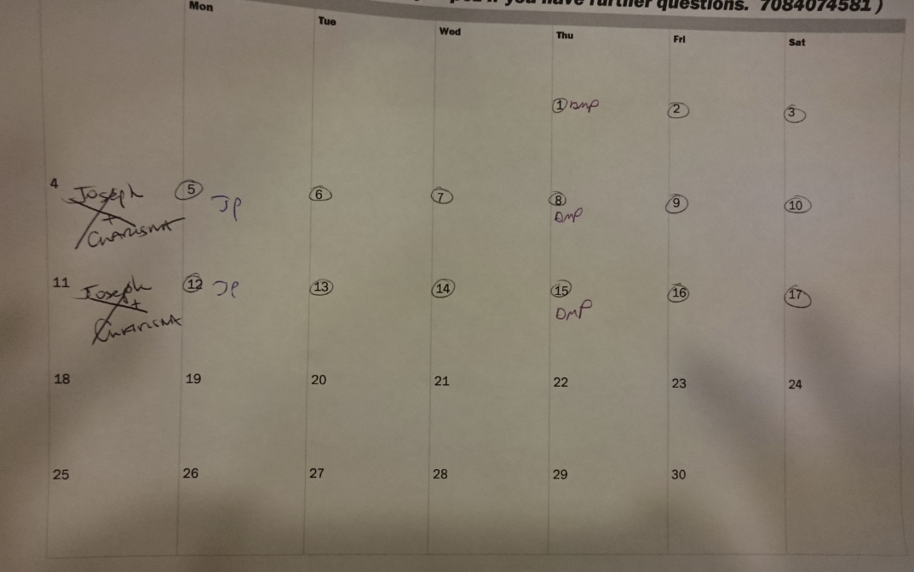
campus outreach
Who is doing it?
Not many!?
Individual-based
Little measurement
But, the heart is there!

Slide 5
Campus outreach is who we are (Mission statement)
“Triton-UBF is a community of believers committed to growing in the likeness of Christ Jesus and to sharing his gospel with college students, teenagers, families and others through one to one, and group Bible studies. Our main focus is to know and obey God through the study of the Bible and to raise lifelong disciples of Jesus who live by his grace and teachings. Triton-UBF seeks to be a World Mission Center, participating in God’s plan to advance the spread of the gospel across the world through corporate prayer and through the raising and supporting of lay missionaries.”

Slide 6
Campus outreach is our covenant as member
Covenant 7: “Work cooperatively to serve the church and its mission as the body of Christ (Acts 2:42-44; 1 Cor 1:10; Phil 1:5; 1 Pe 2:4-5)”
Covenant 8: “Pray for and participate in spreading the gospel and support raising disciples of Christ (John 8:31; Matt 28:19-20)”

Slide 7
What can we do?
Dedication with goals collectively
By the end of year 2016, Triton UBF ministry will have five new disciple candidates who may join worship service or/and one-to-one, group Bible study or other activities in the ministry.
By the end of year 2016, at least 60% of Triton UBF members will actually participate in campus outreach on a regular basis.
Collective action

Slide 8
Outreach activities
Support TBC
  12 Meetings this fall on Tuesday 9/13/16 - 11/29/16
  G-204 on Tuesday 11:00am-12:00pm
  Studying RESET by Dr David Jerimiah, a study of the book of Nehemiah about 10 steps we can take towards spiritual renewal - The Power of God's word; Obedience; Repentance; Worship; Commitment; Giving; Serving; Thanksgiving; Conviction; Purpose
  Triton Corn Roast on 9/14 (Wed) at 11am-2pm, 5:30pm-6:30pm

Slide 9
Tbc prayer topics
RESET: Nehemiah study, God may renew our spiritual walk and become 'do'ers' of his word.
God may raise up group Bible teachers for our study and fill them with his Holy Spirit.
God may help us to impact our campus for Christ with his love, truth and with our obedience to his word.
God may help our TBC team to work in unity and give us inspiration to do his work.
God may bring revival to students hearts and give them a longing for God's word.
God grant us favor in the eyes of tritons administration.
God may raise future leaders for the club.

Slide 10
Tbc members
Amber Bitakis (President)
Cassandra Cano Moguel (VP)
Susan Burk (Secretary)
Sammy Heusel
Nonso Ukeka
Diana Perez
Charisma Magno
Ruth Portugal
KC Ukeka
Ikem Ukeka

Slide 11
Ways to support Tbc
Pray for TBC specifically according to the prayer topics
Get to know TBC members by name, encourage them.
Befriend a TBC member, pray with them, invite to go fishing.
Visit them at the club meetings and Tuesdays, support other activities.
Offer to assist in Bible study preparation
Serve snacks for our meetings, they love home baked goods!
Pass out our flyers and invite students to TBC
Even more – see Triton website

Slide 12
Outreach activities
Outreach Day – Mondays 9:00am at campus
Outreach Day – Mondays 6:30pm at campus
Prayer Vigil
Pray Everywhere – 5-minute daily prayers for campus outreach

Slide 13
Sign-up & Meet in group (15min)
Sign-up
TBC Group (Charisma)
Outreach Day – Monday Morning Group (Mark)
Outreach Day – Monday Evening Group (Elijah)
Prayer Vigil (Tim)

Slide 14
regroup (10min)
Summary
Selecting good ideas
Getting suggestions

Slide 15
Reports from team leaders
Outreach & World Mission
Spiritual Growth / Discipleship & Mentoring
Prayer
Serving
Communication
Giving

Slide 16
Announcement & Prayers
Next Membership meeting on 11/13/2016 at 1:00pm
Quarterly meetings next year
Leadership meeting: 10/30/2016 at 1:30pm
Prayer topics by Pastor

Slide 17
Recapturing Reflection
"The harvest is plentiful, but the workers are few. Ask the Lord of the harvest, therefore, to send out workers into his harvest field." (Luke 10:2)

