Slide 1
WORLD MISSION
Notes:
Welcome to our class on World Mission!
This class will be a tutorial on the heart of world mission that we would like our members at Triton U.B.F. to share in.
We plan to cover our common understanding of world mission from its origin to its vision.
Our hope and prayer is that God’s love for the lost souls may also be imparted to your heart more and more.
Let us begin!

Slide 2
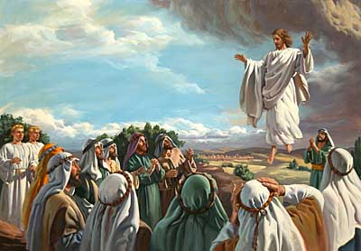
Key Verse Matt 28:19
“Therefore go and make disciples of all nations, baptizing them in the name of the Father and of the Son and of the Holy Spirit…”
Notes:
The key verse of this class is Matthew 28:19. Let us read it together.
Let’s consider how this was Jesus’ very last command to his disciples before his ascension.
Think about the moments that you give a loved one your absolute most attention! When are they? (get a few answer’s from the audience)
Our Lord Jesus decided to leave this command with his disciples at a time where they would be the most attentive to him, his ascension.
So let us take the time now to observe this subject with that same awe and thoughtfulness that Jesus wanted from the 11 disciples on that day.
At this precious time Jesus decided to share his heart for the nations with his followers once again. So as we go through this class we want to think deeply how we to can share in His heart.
To start off we are going to look at where God’s world mission vision began. Can anyone guess where?

Slide 3
The Beginning of World Mission
“…Be fruitful and increase in number; fill the earth and subdue it…” Gen 1:28
Notes:
Genesis is a wonderful book where we can find the beginnings of many things and effects, including world mission. Along with planting the garden, God also planted the seed of world mission into man’s heart.
Let’s read God’s first words to man together…
In contrast to Jesus leaving the great commission as his farewell words to man, and our Heavenly Father speaks these as his very first words to man.
Imagine the attentiveness that Adam showed to these first set of words from his Creator. Evidently this was God’s plan from the beginning.
According to Genesis 1:28 we see that the origin of world mission came with the origin of man. It was both God’s and man’s greatest practical priority.
Everyday he would go out filling and subduing. And when he grew tired he rested. But after he rested he went to new undiscovered parts of the world to fill and subdue again. In God’s eyes Adam shared in His heart to raise a beautiful world where God and man would dwell together forever. (Rev 21:3)

Slide 4
God’s Plan of Redemption
“I will make you into a great nation, and I will bless you; I will make your name great, and you will be a blessing. ³ I will bless those who bless you, and whoever curses you I will curse; and all peoples on earth will be blessed through you. ”
Gen 12:2,3
Notes:
But man sinned and God began a new plan of redemption.
Now let’s read Genesis 12:2-3
When God visited Abraham the very first thing he promised him was to make him into a great nation and to bless the world through him. This was the promise of the Messiah, our Lord Jesus.
Just like in the garden, we see God wanting to work with man to make a people that God could dwell with.
What do you think we can conclude here? (wait for an answer or two)
---If this was God’s heart for the world from the beginning, what can we say about God’s heart today?

Slide 5
What About Today?
God’s Restorative Plan
“¹⁶For God so loved the world that he gave his one and only Son, that whoever believes in him shall not perish but have eternal life. ¹⁷For God did not send his Son into the world to condemn the world, but to save the world through him.” John 3:16,17
Notes:
Has God lost his heart to raise up a people for himself in this sinful world?
NO
Even though we sinned and separated ourselves from God, he did not lose his world mission vision for us. God still wanted to make his dwelling with us and save us from our sins by sending Jesus. Let’s read John 3:16, 17.
He sent His Son because he deeply loves the world. Because of His Son, God can now reach into every dark heart in this world without an ounce of judgment on their soul.
This is the great news!

Slide 6
Defining World Mission
“¹⁹ Therefore go and make disciples of all nations, baptizing them in the name of the Father and of the Son and of the Holy Spirit, ²⁰ and teaching them to obey everything I have commanded you. And surely I am with you always, to the very end of the age.” – Matthew 28:19,20
Notes:
(Most churches use the term World mission) So what do we mean when we use the phrase “World Mission?” Let’s clearly define what this means.
A mission, in a general sense, is when someone sets out to achieve a strongly felt aim or ambition of their choice.
This requires a “vision.” What is in our vision will determine the mission we set out to accomplish.
Our Heavenly Father has a mission of His own and invites his children to share in it.
Let’s read Matthew 28:19-20 together. The command following the word “Go” is the mission. The words “make disciples of all nations” is the vision.
World mission on a fundamental level is going into all of the world and sharing the gospel message through word and deed.

Slide 7
Why is World Mission important to God?
God loves us
”…God our Savior, ⁴ who wants all people to be saved and to come to a knowledge of the truth.” – 1 Timothy 2:3-4
Notes:
But why is world mission so important to our Heavenly Father?
1) This answer is actually quite simple… It is because of God’s deep love for us.
The God who took the time to fashion us in his own image did so because of his great love for us.
Therefore, one reason we reach out to the lost is because of God’s love for them.
In his love for us he wants all peoples of all nations to be saved.
Let’s read 1 Timothy 2:3-4. (Might also read Eze 18:32 – “For I take no pleasure in the death of anyone, declares the Sovereign Lord. Repent and live!”)
God sees the challenging people of today as harassed and abused and defenseless. He sees them like tender lambs who have no shepherd to take care of them.

Slide 8
Why is World Mission important to us?
Because God commands It
(2) To share and grow in God’s heart for the lost.
When they had finished eating, Jesus said to Simon Peter, “Simon son of John, do you love me more than these?”
“Yes, Lord,” he said, “you know that I love you.”
Jesus said, “Feed my lambs.” - John 21:15
Notes:
While there are many nice reasons for us to share in world mission, there is ultimately one that we believe is foundational.
Jesus’ last command to his disciples before his ascension was to go and make disciples of all nations …. for all disciples of all times. God expects us to carry on Jesus’ salvation work until he comes again. It is not optional.)
(2) It is because we want to share and grow in God’s heart for the lost. We want to be burdened for them just has He is burdened.
When we look at the John’s gospel we see that the final passage is an account of Peter’s reinstatement.
Look at John 21:15.
One of the fundamental ways we love God is by loving his lambs; whether its your neighbor, your enemy, those in authority, or even those under your authority.
To love God, is to love the lost.
Praying faithfully that God would use us in this way is also vital.

Slide 9
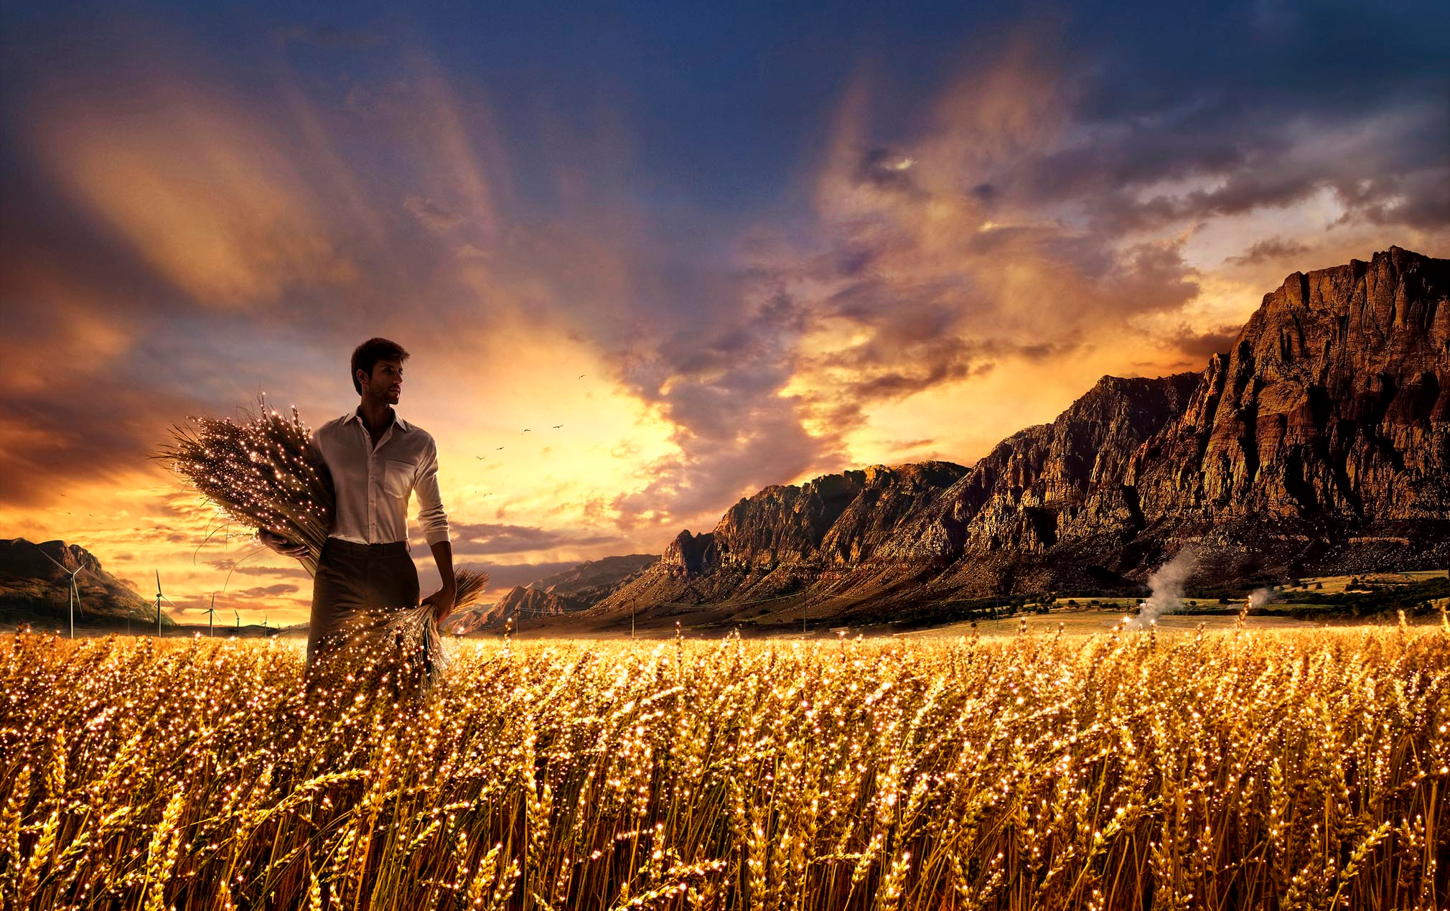
Why is World Mission important to us?
“He told them, ‘The harvest is plentiful, but the workers are few. Ask the Lord of the harvest, therefore, to send out workers into his harvest field.’” – Luke 10:2
Notes:
Let’s read Luke 10:2.
Here Jesus’ shows a sense of urgency for more harvest workers. For some reason there always seems to be a lack of workers.
As Christians, we can sometimes forget God’s love for the world around us. We can neglect the approach Jesus commanded (to pray for harvest workers).
It’s urgent for us to continually pray for a stirring of hearts in God’s people. It is crucial for us to see the need of reaching the lost. Today we are in desperate need for harvest workers.
Have you thought about where your harvest is? Do you know where God wants you to share in his heart? As you consider being involved in world mission, we want to share with you a few ways that you can participate here at Triton.
Coming Back – As a ministry we recognize that we have been lacking in heart for world missions. We are praying specifically for revival in this category. We would like to encourage our members to consider this prayerfully and pray for revival as well.

Slide 10
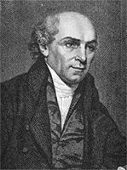
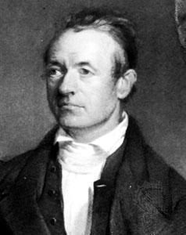
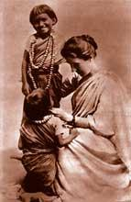
Historical Examples
William Carey
Adoniram Judson
Amy Carmichael
Notes:
http://www.whatchristianswanttoknow.com/10-famous-christian-missionaries/
When God’s people capture God’s vision for a dying world, they are compelled to do whatever they can to share the gospel. History is full of people who gave up their youth, their careers and their physical comfort and well-being to reach the lost throughout the world. Here are some Examples of faithful missionaries in history give us inspiration to share the gospel:
William Carey 1761 - 1834
Carey grew up in the Church of England but was saved while an apprentice to a shoemaker. He eventually joined the Baptist church and went to India as a Baptist missionary. As a self motivated learner he taught himself Latin, Hebrew and Greek.
He founded the Baptist Missionary Society and was instrumental in influencing many other missionaries to the foreign field; particularly to India.
Adoniram Judson (1788-1850)
Judson was a Baptist missionary who became the first North American Protestant missionary in Burma (Myanmar). Like other early missionaries, he was involved in translation work and church planting. He went to the field of India as a Congregationalist but, after much study of the Bible, became convinced that Baptist doctrine was more biblical. Because of anti-Western sentiment in India, he moved to Burma.
It took him 12 years to see his first 18 converts. By the time he died he had established 100 churches with over 8,000 members. The Baptist churches of Myanmar celebrate “Judson Day” each year to commemorate his arrival in the country.
Amy Carmichael (1867-1951)
Amy Carmichael was an Irish missionary who served in India for 56 years without ever returning to her homeland. Her primary work was with orphans in the southern region of India. She was influenced to consider a career in missions after hearing Hudson Taylor speak about the need for missionaries in China. She applied to be a missionary with the China Inland Mission (Taylor’s missionary group) but was eventually turned away because of her poor health. Many of her final 20 years of life was spent in bed due to illness and injury from a fall. Read more: http://www.whatchristianswanttoknow.com/10-famous-christian-missionaries/#ixzz3PnZCJZ2K

Slide 11
Church Activities / Outreach
World Mission Night
Writing/Emailing Missionaries
Hosting Missionary Families
Overflow (Friday Nights)
Conferences
TBC
2 x 2 Evangelizing
Visiting Missionaries
One to one Bible Study
Notes:
Here are some of our outreach activities:
Our main method of evangelizing is through 1:1 Bible study. To accomplish this, we engage in 2X2 evangelism (fishing). Many of our committed members are encouraged to visit campus and share the gospel as well as invite students to Bible study
World Mission Night – Missionaries from outside of the country come to share reports of what is happening in their ministries. They share their experiences, trials, and victories in the mission field. After words they share their ministry prayer requests and all those attending this event pray for them. The members who attend this event are encouraged to keep praying for them personally.
Conferences – UBF holds conferences in various other countries that outsiders encouraged to attend. Also conferences are held throughout the U.S. These events have sections where missionaries from outside or even inside the U.S. share their reports and prayer requests from their mission field.
Hosting Missionary Families – Missionaries come to stay with you in your home to receive Bible study and rest. The hosting family commits to serving and providing an enjoyable time for them. The goal of this is for them to be refreshed, encouraged, appreciated, and prayed for.
Writing / Emailing – We write them to stay in touch. The goal of this is keep encouraging them, praying for them, and understanding their needs.
Triton Bible Club – Students are encouraged to host a Bible club on campus. The club is used as a place where students can come and be taught the word of God. The goal of this is to lead the students to Christ and to be a source of light for the students.
Overflow (Friday nights) - On Friday nights we have an gathering for the college students of our ministry. There is a portion of the meeting that is devoted to world mission. We look at what God is doing around the world as well as the spiritual condition at these locations.
Participation in food pantry support and such projects as the 30 Hour famine are designed to extend a practical arm of love and compassion to the lost world around us. We do these things because they are a way to reflect the love of Christ for a lost world and hopefully, open the door to new opportunities to share the gospel.

Slide 12
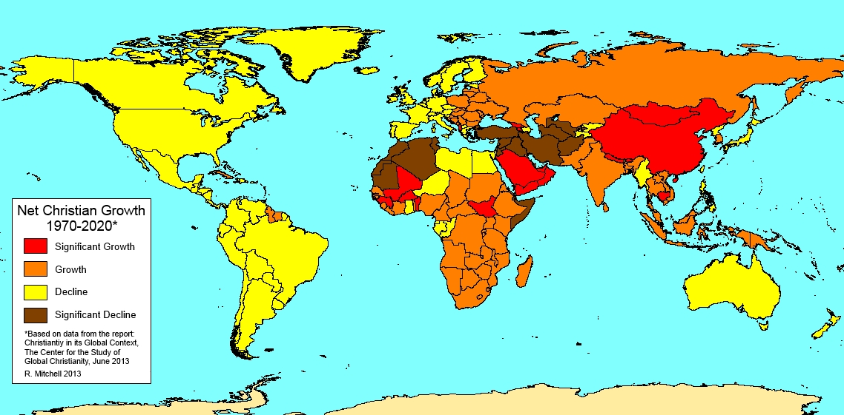
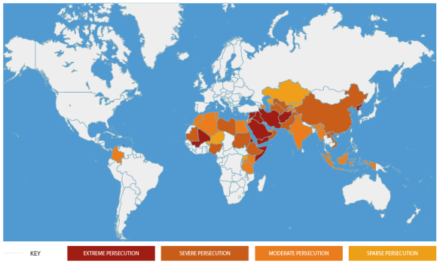
Short & Long-Term Missionaries
https://discipleallnations.wordpress.com/tag/center-for-the-study-of-global-christianity/
Notes:
If God has placed a specific country or heritage on your heart, you may want to pray about being sent out as a missionary.
Here are 2 maps that show where christianity is growing and where persecution is happening.
Our chapter that has sent out short-term and permanent missionaries. The families from Triton that we are praying for that are in the mission field are the Marjis (will get a picture) & the Sagels (will get a picture).
Typically, our missionary work looks like this:
UBF evangelists hold professional jobs while engaging in missionary activities, following the Biblical example of the Apostle Paul. These missionaries have advantages as follows:
If you are a student or employee, there are many opportunities which arise naturally to make friends with nationals, to witness to them and/or and to invite them to Bible study.
Even in anti-Christian countries, lay missionaries can enter as factory workers, doctors, nurses, business men, embassy workers, students, English teachers, professors, engineers, etc.
We are praying for God’s timing in regards to sending out more missionaries. If at anytime you feel this calling on your life, we encourage you discuss this with our elders so that they may advise you and pray for you.
http://www.setapartpeople.com/evangelize-yshua

Slide 13
Other College Ministries
Notes:
There are various other college ministries that share the same mission and vision as we do here at U.B.F.
Campus Crusade for Christ (Cru): Started at 1951 on the UCLA campus, Cru began by Bill and Vonette Bright. Since then God has blessed them to fruitfully expand to campuses in about 190 other countries.
InterVarsity Christian Fellowship: Started in the 1870s in Great Britain. The first chapter began at the University of Michigan in 1938. From Great Britain and U.S., InterVarsity has similarly spread throughout the country.
These campus focused ministries, along with various others, share the same calling to a college campus mission field as we do. We all want to win non-believers, raise disciples, train leaders, and share the love of God to even more and more countries. We pray that the Holy Spirit would continue to stir our hearts more and more, to reach the sheep and lambs of college campuses around the world.

Slide 14
Q & A

